Slide 1
Rule to table to graph – part 3
Miss L
Year 7

Slide 2
Learning Intentions
Students will be able to
Fill in a table using just a rule
Graph the rule

Slide 3
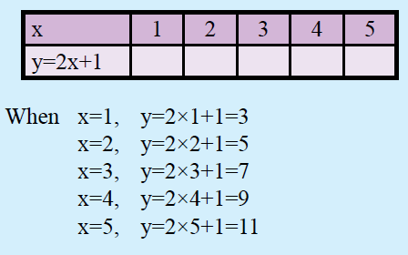
24
7
30
Linear Relationships
Date:
EQ – How do we fill in a table using just a rule?
Steps to filling in a table from a rule.
Step 1
Given the rule, complete the table by substitution
y = 2x + 1

Slide 4


Slide 5
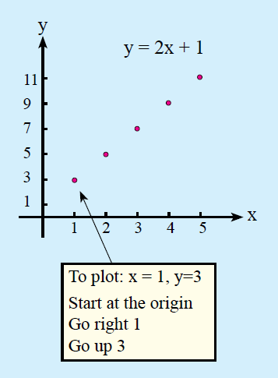

24
7
30
Linear Relationships
Date:
EQ – How do we fill in a table using just a rule?
Steps to filling in a table from a rule.
Step 2
Plot the coordinates on the graph

Slide 7
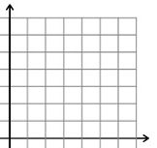
Practice
Notes:
Guide students through the question.
Option 2: Dot plots handout (Scaffolded for kids who may need extra help)

Slide 8
Practice
Notes:
Guide students through the question.
Option 2: Dot plots handout (Scaffolded for kids who may need extra help)

Slide 10
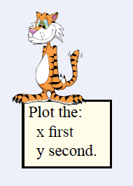
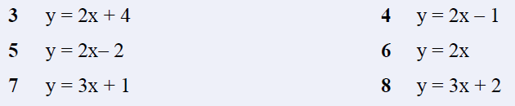
Task
Fill in a table for each of the following rules
Graph the coordinates on the graph
Notes:
Guide students through the question.
Option 2: Dot plots handout (Scaffolded for kids who may need extra help)

